Slide 1
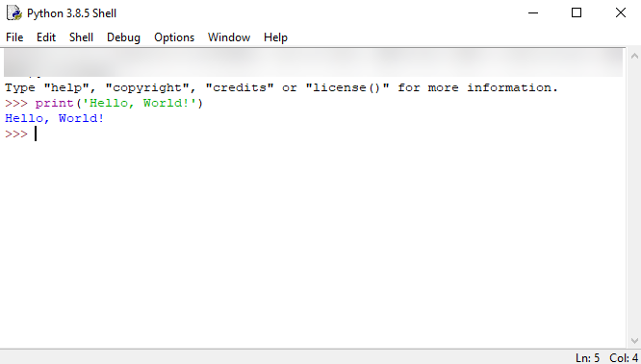
Systems that need to be programmed to control certain aspects.

Slide 2
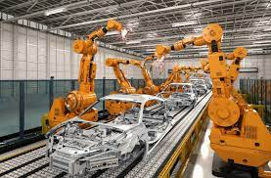
Robotic Car Factories
Most of the programs are pendants, which are handheld devices that contain buttons to allow someone to control the system of the robotics.
These pendants bring many benefits to the company as they: allow a large amount of leeway and customizability during the manufacturing process, this further enhances safety, and it allows for people to work from home.
However, they also pose issues as they: cost even more money on top of the robotic car factory system and they need even more maintenance to make sure there are no malfunctions.
The basics of all code to control this type of thing is a coding language, the main two for these are python and C ++.
These factories can bring many benefits to the company as they: increase efficiency, improve the quality of the manufacturing process and make the area much safer due to the reduction of the risk of human error.
However, they also pose many issues as they: have a large initial cost, are complex to create and may require a large amount of effort to make and they also need maintenance to keep them running efficiently.

Slide 3
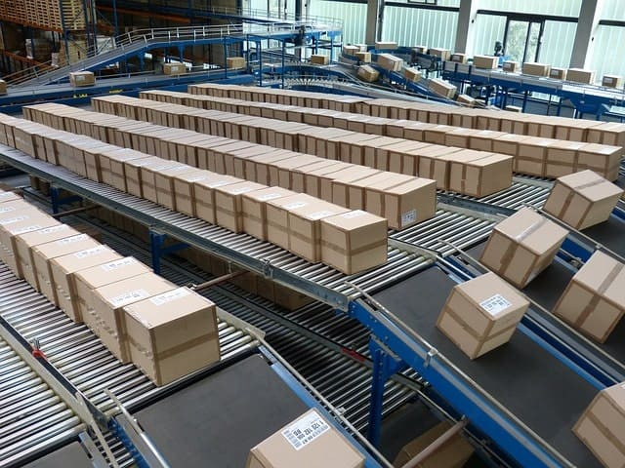
Robotic Car Factories
Automated warehouses
Most of the programs are pendants, which are handheld devices that contain buttons to allow someone to control the system of the robotics.
These pendants bring many benefits to the company as they: allow a large amount of leeway and customizability during the manufacturing process, this further enhances safety, and it allows for people to work from home.
However, they also pose issues as they: cost even more money on top of the robotic car factory system and they need even more maintenance to make sure there are no malfunctions.
The basics of all code to control this type of thing is a coding language, the main two for these are python and C ++.
These factories can bring many benefits to the company as they: increase efficiency, improve the quality of the manufacturing process and make the area much safer due to the reduction of the risk of human error.
However, they also pose many issues as they: have a large initial cost, are complex to create and may require a large amount of effort to make and they also need maintenance to keep them running efficiently.

Slide 4
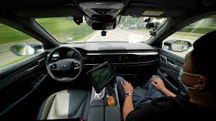
Robotic Car Factories
Driverless Cars
Automated warehouses
Autonomous vehicles utilize Ai to be able to drive by themselves. They are fed data in machine learning algorithms, basically meaning that they learn human patterns on where they travel on the road as well as from already existing data such as maps and satellites to identify things such as pedestrians and traffic lights.
The benefits for the future are that they will increase road safety and they can automate many more services such as delivery.
On the other hand, there are security issues about malfunctions causing a vehicle to not stop at the correct time and to crash, the risk of jobs been lost due to the automation of things such as delivery too and they would cost to develop this program.
Most of the programs are pendants, which are handheld devices that contain buttons to allow someone to control the system of the robotics.
These pendants bring many benefits to the company as they: allow a large amount of leeway and customizability during the manufacturing process, this further enhances safety, and it allows for people to work from home.
However, they also pose issues as they: cost even more money on top of the robotic car factory system and they need even more maintenance to make sure there are no malfunctions.
The basics of all code to control this type of thing is a coding language, the main two for these are python and C ++.
These factories can bring many benefits to the company as they: increase efficiency, improve the quality of the manufacturing process and make the area much safer due to the reduction of the risk of human error.
However, they also pose many issues as they: have a large initial cost, are complex to create and may require a large amount of effort to make and they also need maintenance to keep them running efficiently.

Slide 5
END
Driverless Cars
Autonomous vehicles utilize Ai to be able to drive by themselves. They are fed data in machine learning algorithms, basically meaning that they learn human patterns on where they travel on the road as well as from already existing data such as maps and satellites to identify things such as pedestrians and traffic lights.
The benefits for the future are that they will increase road safety and they can automate many more services such as delivery.
On the other hand, there are security issues about malfunctions causing a vehicle to not stop at the correct time and to crash, the risk of jobs been lost due to the automation of things such as delivery too and they would cost to develop this program.
Most of the programs are pendants, which are handheld devices that contain buttons to allow someone to control the system of the robotics.
These pendants bring many benefits to the company as they: allow a large amount of leeway and customizability during the manufacturing process, this further enhances safety, and it allows for people to work from home.
However, they also pose issues as they: cost even more money on top of the robotic car factory system and they need even more maintenance to make sure there are no malfunctions.

Slide 6
END
👍

